Slide 1
Build a business web site for a construction engineering material testing company
By FZ programming and analysis company

Slide 2
1. Introduction
This presentation refers to the Information System Analysis and Modeling project, whose objective is to create a web-based system for technological control of construction materials and soil survey.
This document includes the feasibility study, the analysis phase, and the system’s design, with the aim of apply the concepts learned in class and practice applying agile planning methods.

Slide 3
2. General context
In civil engineering, the technological control of building materials and soil analysis represents an important sector.
The soil analysis is done even before starting a construction project, so that the loads that need to be supported are determined and the types of foundations are defined.

Slide 4
The technological control is mainly used to verify the resistance of the materials applied in loco
In this case, when applying these materials, samples are taken and the laboratory makes resistance and quality tests
All constructions applying these materials must carry out qualitative tests in accordance with established international standards

Slide 5
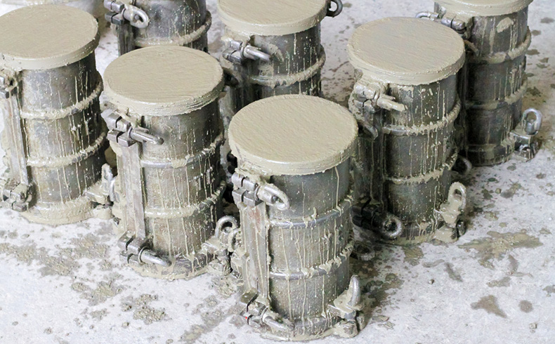
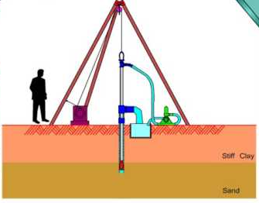
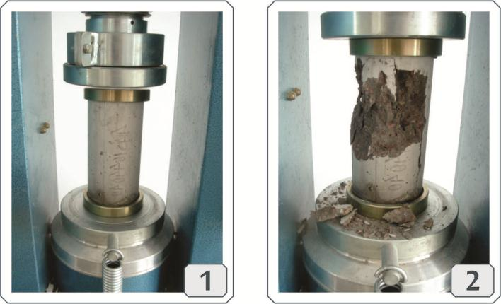


Slide 6
In this way, a system that facilitates the contracting of this type of services is an excellent business opportunity.
The system allows the client searching the service, registering an account, booking an appointment, paying the fees and following the service status.

Slide 7
3.The goal of building this web site:
This is a business web-system, build for a company of Construction Engineering Material Testing Laboratory – CEMTL that provides services on quality inspection of construction materials.
grants a relationship of contact, communication, and interaction between the company and its customers. Whit this system, the company can improve your professional services offer and the customers can use these services in a convenient way.

Slide 8
4.Feasibility study
4.1 End users
4.2 Requirements
4.3 Some functional requirements that can be added in the...
4.5. Analysis by P.I.E.C.E.S
4.6 Operational and Cultural study

Slide 9
4.1 End users
The employees of the laboratory (for example the engineer who issues his analysis opinion);
The Construction company who want to use the services that CEMTL provide (if a construction company is building a condo, and it want to test the quality or the level of the material that is used, or it want to realize a construction quality control.
The government (for example, when it is necessary to build a Bridge across the river or renovate the pavement of streets and roads, it is mandatory to do the control analysis of the material).
The person who want to build or repair his house or other building and wants to use the service to test the construction materials (for example, somebody who wants to renew the roof of his house using asphalt roof and needs to know how to evaluate and management the process.

Slide 10
4.2.Requirements
Functional requirements:
To register 4 different types of user accounts:
- employee account, account id starting by number 0;
- customer VIP account, starting by number 1;
- company account, starting by number 2;
- personal account starting by number 3.

Slide 11
Reservation appointment or book one of the service listed at the web site.
Filling the application service form online;
Online payment for the fee of the reserved service;
Upload some large size files, like videos, pictures and documents;
Online check the status or the steps of process of the material testing;
Download the final report made by the testing engineer;

Slide 12
4.3 Some functional requirements that can be added in the future
The web visitor can communicate with customer service consultants online real-time;
The engineer provides the service for the remote meeting and technical support;
Company recruitment information for CEMTL to hire engineers when they need to expand new business;
Information about possible new branches of CEMTL.

Slide 13
4.4 Nonfunctional requirements:
The web site can be visited by web browser, smart phone, tablet or another handheld device;
Can be display in two languages by choose: English or French;
The payment can use Canada dollar or Us dollar;
Can accept Multiple payment methods: credit card, us credit card, check, debit card, Bank Transfer;
When in the web site, the user can see the introduction of CEMTL, some big project details of accomplished projects.

Slide 14
4.5 Analysis by P.I.E.C.E.S
4.5.1 Performance
Use some Techniques of Website Speed Optimization:
Use a better host server to keep our website
Minimize the number of JavaScript and CSS files
Use a Content Delivery Network (CDN)
Optimize the size of images on your website
Reduce the number of plugins
Database optimization in CMS
Reduce the use of web fonts

Slide 15
Such techniques will be used to make website performance faster and more efficient, as well as maintaining high download and upload speed. It’s estimated that the system has 3 seconds maximum response time for predefined request, and 7 seconds maximum for other requests.
In terms of system stability, other techniques can be applied, such as:
Proper Server Monitoring,
Test System Restoration Procedures
Implement Corporate Collaboration Tools
Use Big Data Analytics to Predict Outages

Slide 16
4.5.2 Information and data operating
When users enter information or data, the system can analyze such data and guide them to enter the correct data, for example: when
entering the date or phone number, they can only enter them in the correct format. The system can also provide a lot of tips to help correct input of information and avoid some human error or other errors.
We believe that the data stored is the most important thing, so our team of database technicians will perform regular maintenance and technical support, and often check the data center stability.

Slide 17
For outbound information, the use of links allows you to provide more data to choose from users, who may choose to see only the information they need. For example, when users wish to search for a service, they will see the list that presents the introduction of each service, being able to select and access the chosen link correctly from the beginning of the user experience.
Considering the basic information of the system, such as contact area, company history, and service detail, it is important to point out that the system will have the most relevant information described
with the minimum number of words possible. The succinct way of describing the services helps the end user in their decision making.

Slide 18
4.5.3 Economics
According to the preliminary analysis of the cost and benefits of this project, it was possible to observe that the complete implementation does not present exorbitant costs. This means that at relatively low costs the benefits can be increased and varied quickly. Further details can be found in the feasibility study presented later.
Considering the benefits of the system, one of the ways to monetize this type of system is to make the platform available to other material's laboratories by rent, that means an annual payment to obtain the license to use the system.

Slide 19
4.5.4 Control and Security
The type of information generated by the testing of materials is an information that is usually treated as a public domain, since it must be available in management reports of works and for the
knowledge of possible future buyers of the project (when it comes to civil construction), as well as for taxpayers' knowledge (when it comes to building bridges or pavements). In order to do this, the system security issue should be focused mainly on the protection of customer data and the making of online payments.

Slide 20
In order to make the system safe and secure, some rules will apply, such as:
always check both username and passwords and verified the security questions.
keep software up to date and use anti-virus software, also use Hardware firewall
protect against XSS attacks
validation should always be done both on the browser and server side
when files uploads, always scan for security
use HTTPS
use md5 encryption

Slide 21
4.5.5 Efficiency
In order to increase the efficiency of the system, technical analysis of the data flow can be used, which can then improve the structure of the site, provide improvements and upgrades, and keep the content of the site efficient and up to date. Another option is to use small details like not putting all the links on the home page and avoiding the delivery and exit of redundant information.

Slide 22
4.5.6 Services
The services provided through the system license lease include personal training, which will be given for a week and may be provided on demand when a new employee joins the company. Technical support 24/7 will be provided, and the company engages in providing warranty response time in just 1 hour. Our professional technicians will visit the company on a regular basis and will perform regular maintenance, according to the needs of each customer.
It should be noted that the system should be compatible with different browsers.

Slide 23
4.6 Operational and Cultural study
The system is considered easy to operate with user-friendly interface and the structure of the web page is clear, having been thought about the local cultural design.
The system can be used by smartphone, tablet and other handled devices. End users can choose the display language between English and French.
A mock-up is presented at the end of this presentation.

Slide 24
4.7-4.10 Benefits and Cost analysis for this project:

Slide 28
Fz Benefit for built the system:
In executing and implementing this project, the benefits of the FZ programming company include two parts:
1. One-time benefits. For example: site compilation fee;
2. Yearly benefits. For example: technical support fee.

Slide 30
4.11 Project schedule estimation use waterfall modeling

Slide 32
5.Project Analysis Part

Slide 33
5.1 Use case analysis: three major functions
The analysis step was performed with the help of the Trello board content which allows describing the product backlog and the user stories, as well as the different users of each system functionality. With the help of this tool, it is possible to divide the tasks into small parts and allocate them in different sprints. Aiming to illustrate the work using Trello, a screenshot is shown below.
With Trello board content, three major functions (that the system will perform) were selected to present in detail, like a use case analysis.

Slide 34
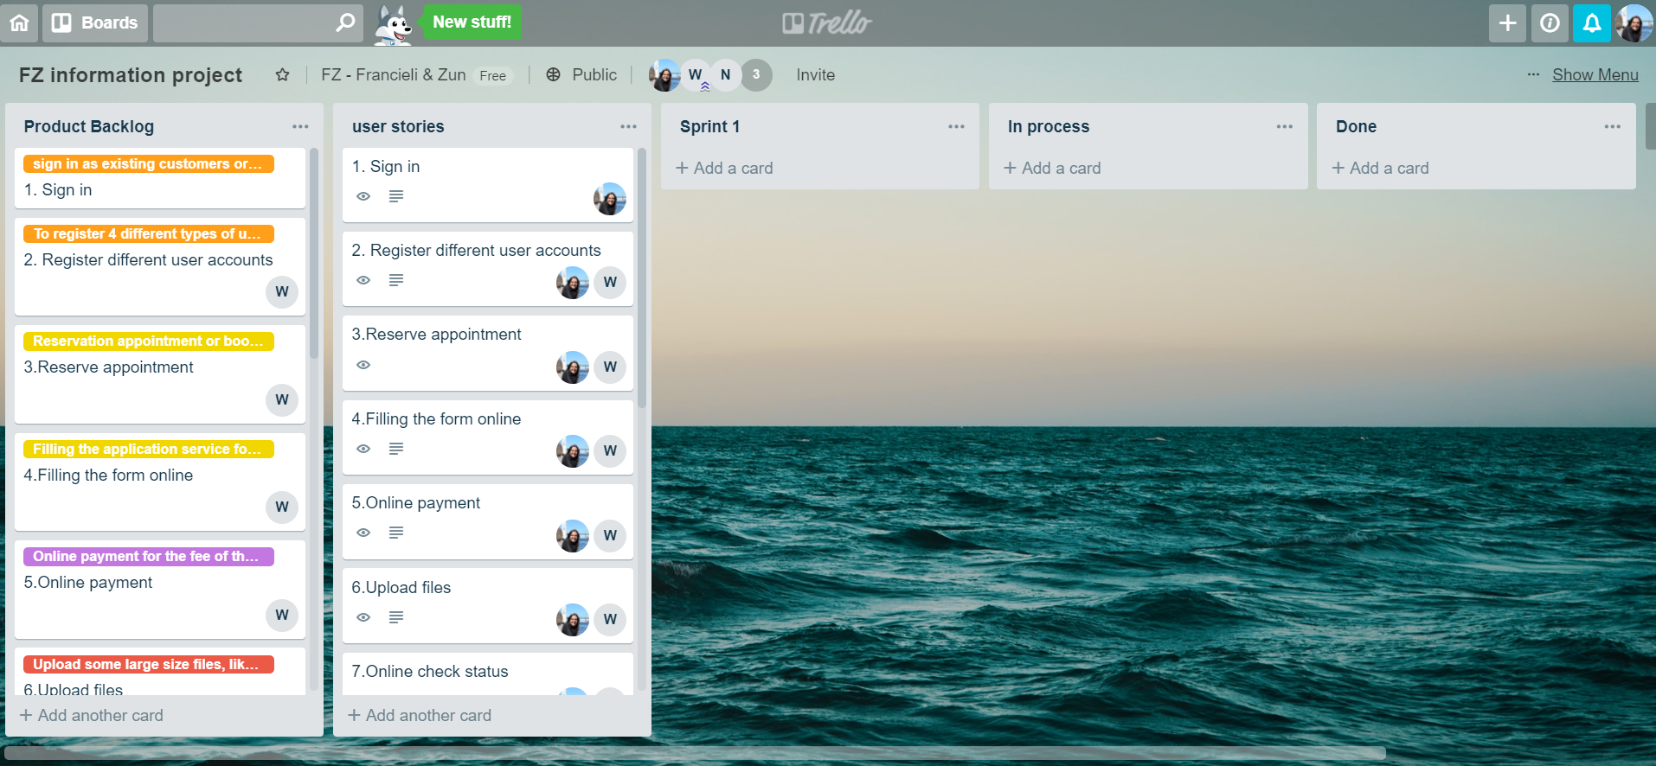

Slide 35
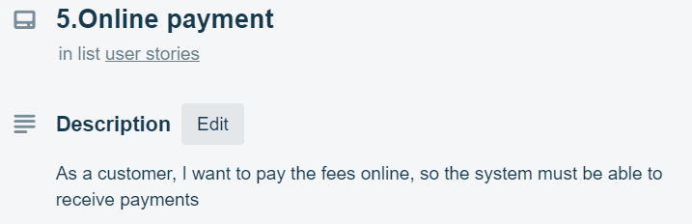
User stories

Slide 36
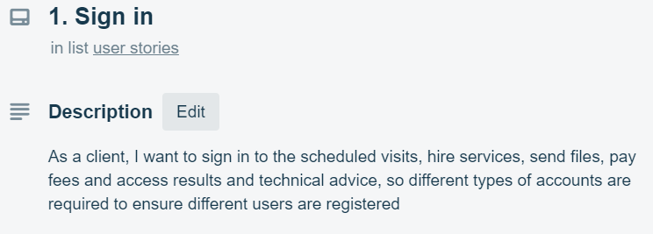
User stories

Slide 37
Use case analysis - 1
Use case name: Appointment reservation or service booking online
Short description: Customer who want to use the service can reserve appointment and book services.
Trigger: When customer fill in and send applied form
Type: External

Slide 38
Major Inputs |  | Major Outputs
Description | Source | Description | Destination
1. Customer general Information or login account 2. The booking service or reserving appointment information 3.building project or material testing documents information 4.Payment online information | 1. Customer input or login 2. Customer input or choose 3. Customer input and provide 4.Customer input | 1. verified of the customer’s general information put inside DB 2. verified of the login information to make sure it is correct 3. verified of the service customers selected and analysis the documents 4.verified of the payment information | 1. confirmation of the input information and acceptation 2.if login information is correct, let customer login 3. confirmation of accepted the customer application 4.confirmation of the payment and return the receipt

Slide 39
Major steps performed | Information for steps:
Step1. Customer login or create a new account and input their general information | Customer provide their general information
Step2. Customer select and book service, and the system display the details about the service | Service information
Step3. Customer fill in the apply form for use the service and send online | Customer provide their project information for apply for use the service
Step4. Customer confirm the input online payment information | Customer provide their bank information for paying online the fee of the service
Step5. the web site system returns the confirmation about accepted the customer’s application | Web site DB system provide the confirmation

Slide 40
Use case analysis - 2
Use case name: payment online | Id: Functional Requirement 4
Short description: customer pay the service fee online by bank card
Trigger: when customer fill the form after book the service
Type: temporal

Slide 41
Major Inputs |  | Major Outputs
Description | Source | Description | Destination
Bank card information The booking service information Customer Information | Customer input Customer input Customer input | Result of verified Card information Confirm information and receipt | Card DB Bank DB

Slide 42
Major steps performed | Information for steps
Step1. customer book service and the system calculate the total amount | Service information
Step2. fill the form for apply for the payment online | Customer information
Step3. customer confirm the input bank card information | Bank card information
Step4. the system return the confirmation about the payment. | Bank confirm information

Slide 43
Use case analysis - 3
Use case name: : Sign up or sign in account for customers | Id: Functional Requirement 1
Details see report.

Slide 44
6. ERD or Class diagram

Slide 45
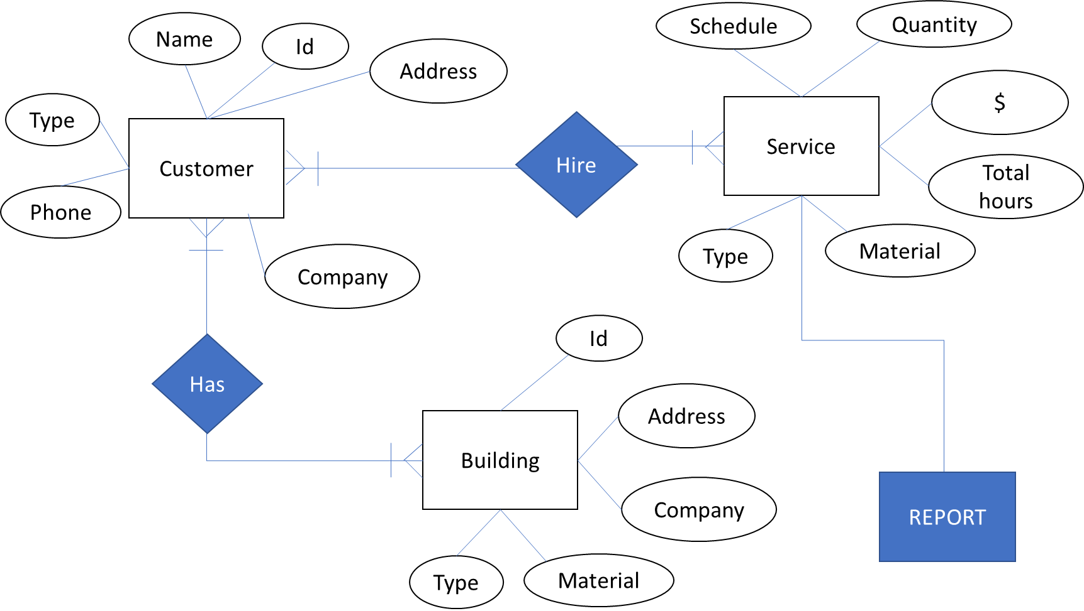
Class diagram - 1

Slide 46
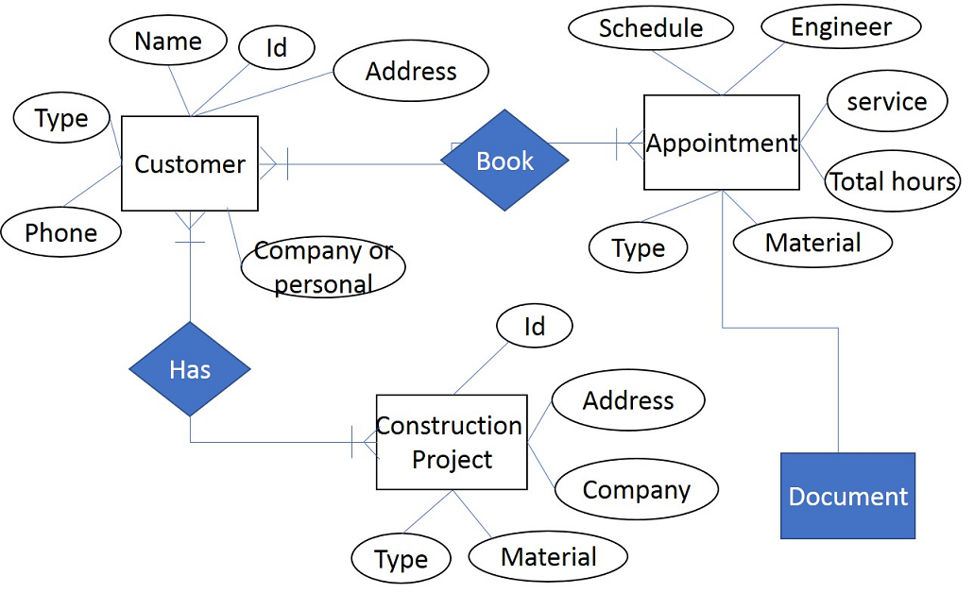
Class diagram - 2

Slide 47
7. UML diagrams: use case

Slide 48
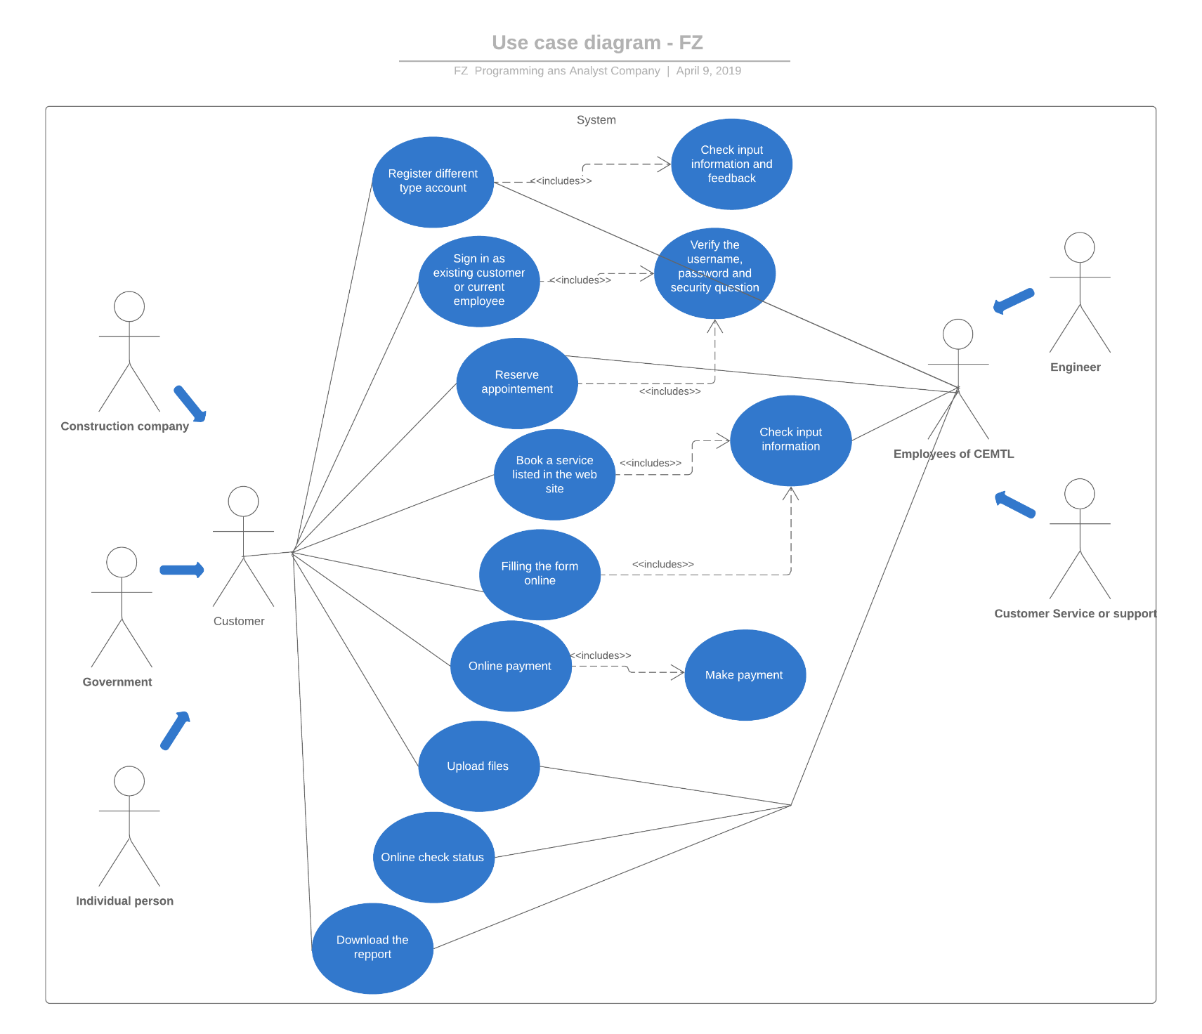
Use case diagram

Slide 49
8 . Web Template Demonstration
Two mockup propositions were created. The first one was the preliminary version, presented in the first stage of the project. It is a navigable model, basically using HTML, CSS and JavaScript.
The second version is only a prototype developed with Adobe XD.

Slide 50
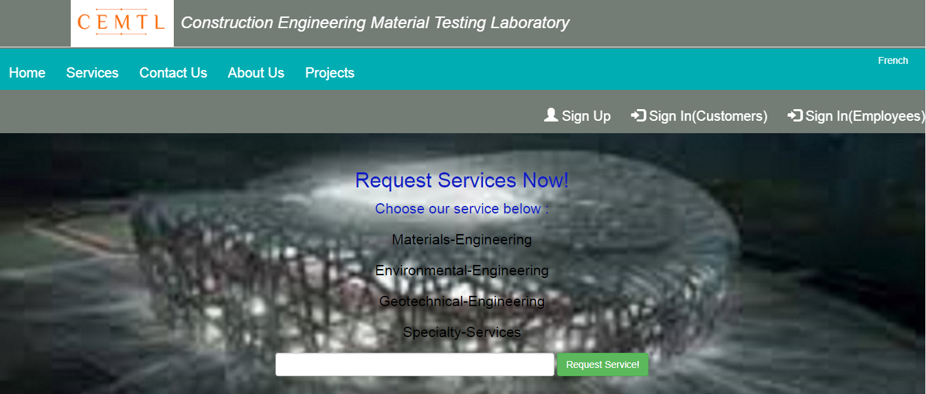
Web Template Demonstration

Slide 51
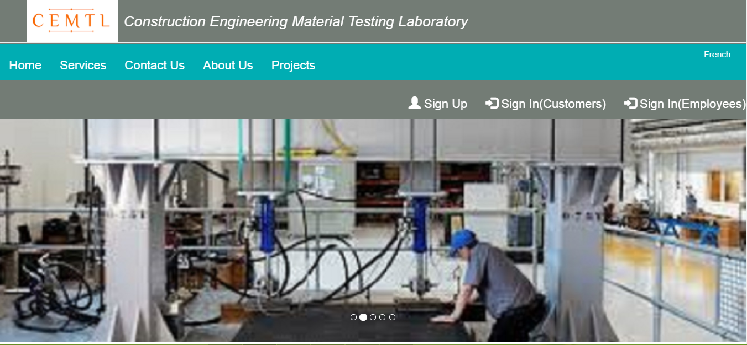

Slide 52
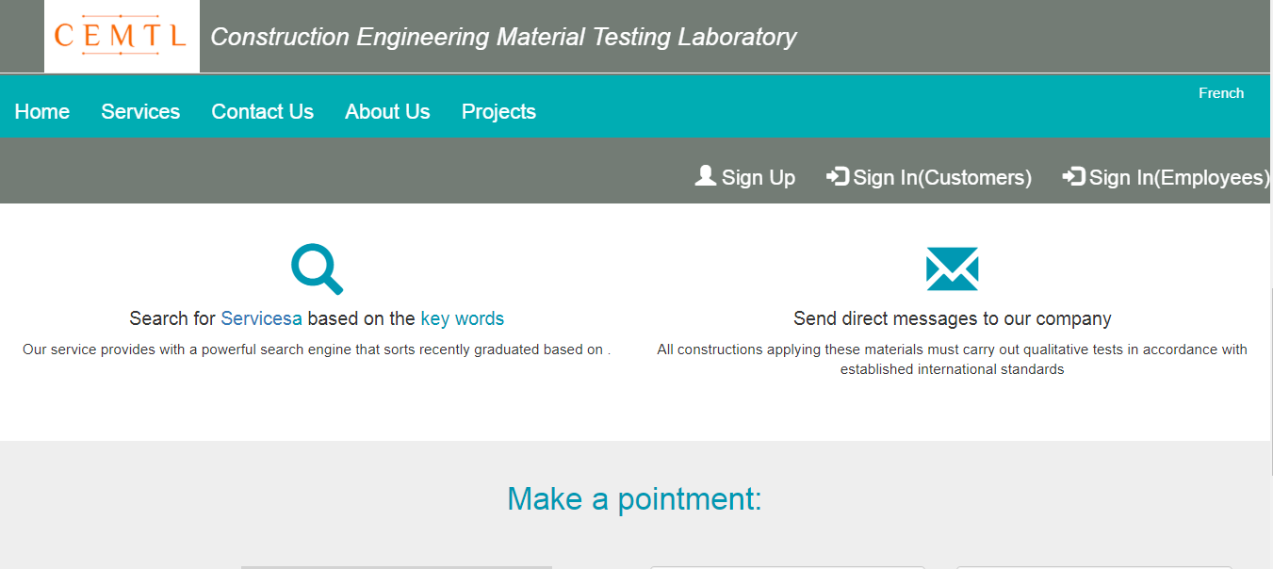

Slide 53
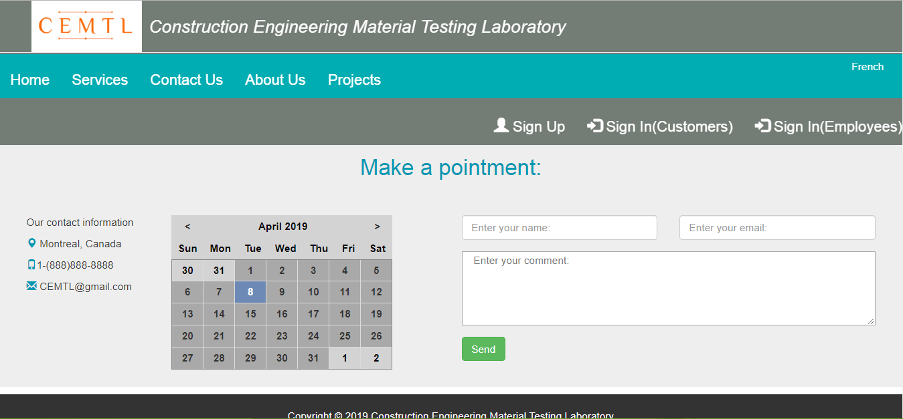

Slide 54
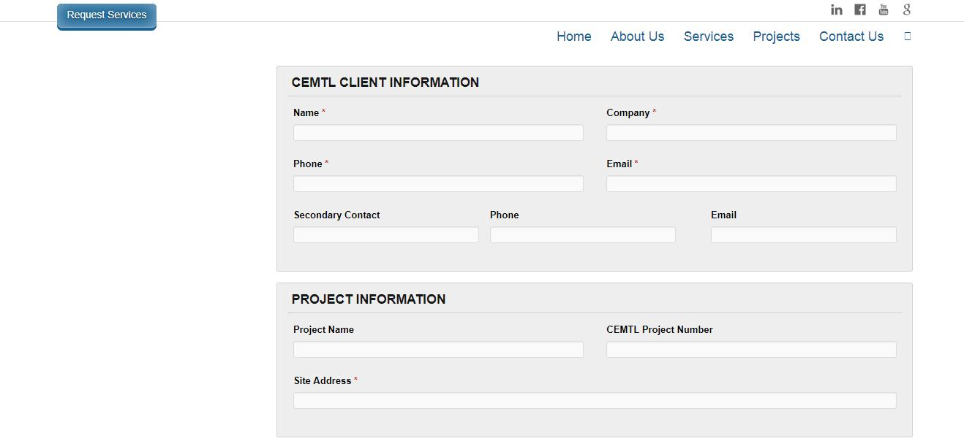

Slide 55
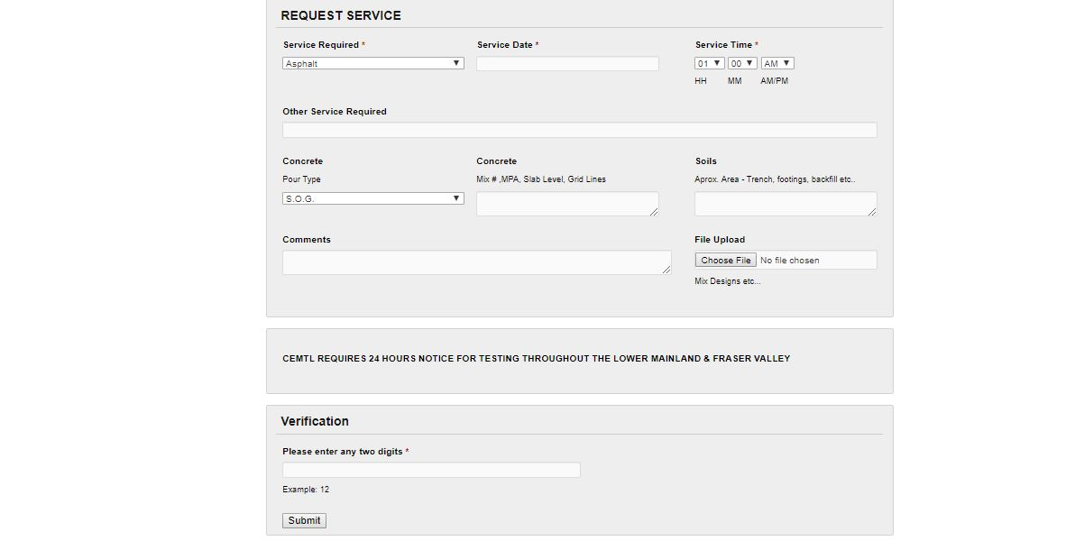

Slide 56


Slide 57
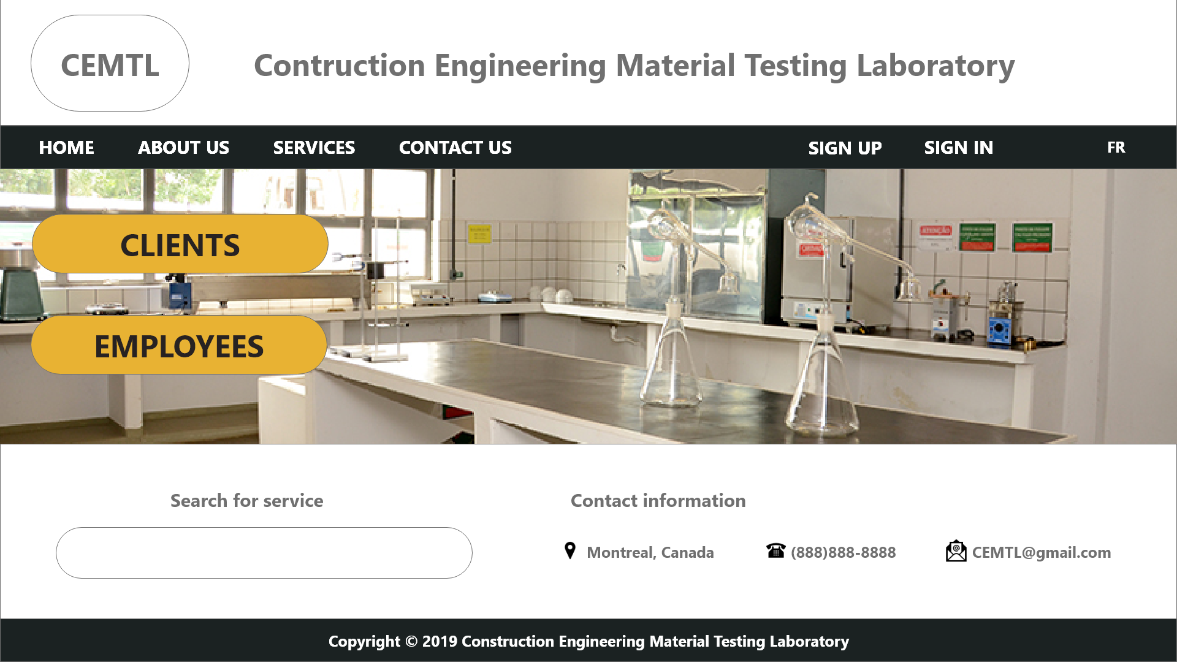

Slide 58
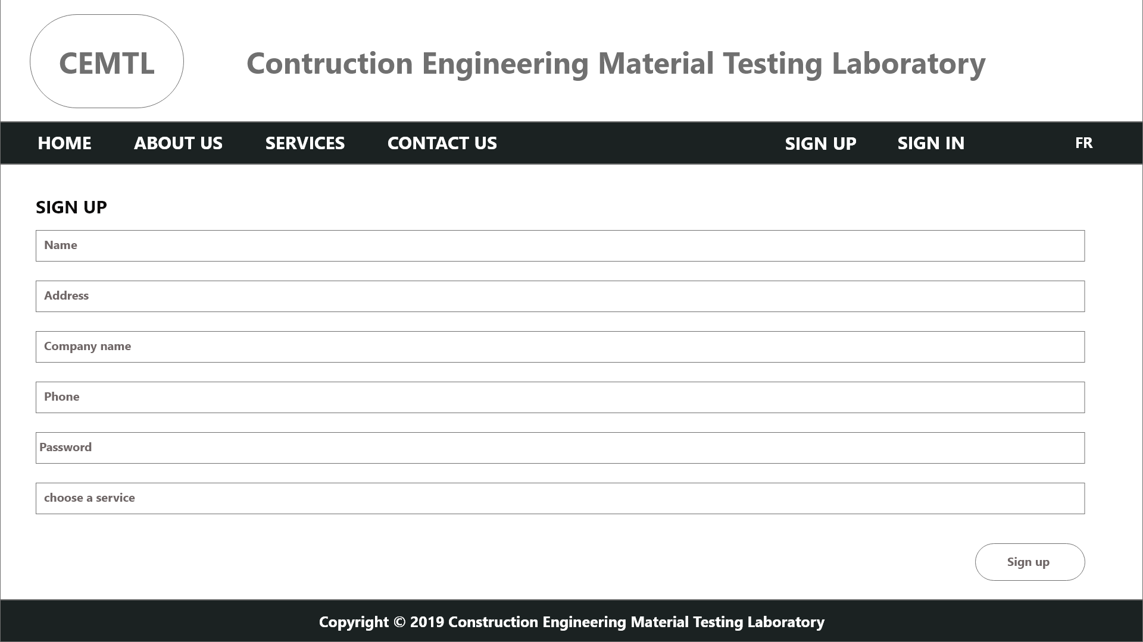

Slide 59
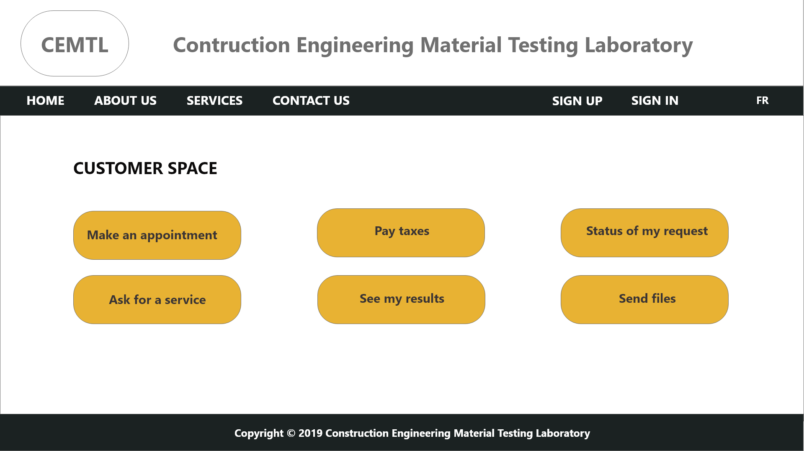

Slide 60


